Slide 1
HowTo: OpenShift Hybrid Windows and Linux
Glenn West, Principle Engineer
How-To

Slide 2
Overview
Azure ARM Templatre (Multi-Host)
OVN Setup
Windows Setup

Slide 3
Where To Find It
Azure ARM Template
https://github.com/glennswest/hybrid-openshift-contrib/commits/master
OVN and Windows Setup
https://github.com/glennswest/hybrid

Slide 4
Usage – 2 ways to use
Use the hybrid-openshift-contrib
Provides the auto creation of a complete cluster and all the related infrasturure.
3 Masters, 3 Infra, 1 or more compute nodes, and 1 or more windows nodes
Requires OpenShift Subscriptions/Rhel and/or Employee Subscription
Requires a Azure Subscription
Hybrid Scripts
Self provision bare metal or Any cloud provider, provide a ansible host file, and use the ansible OVN and Windows scripts. Assume you have a bastion host.

Slide 5
What you get with ARM Template
Bastion Host
3 Masters (3 Vm’s)
3 Infra (3 Vm’s)
1(or more) Linux Compute Nodes 1(or more VM’s)
1(or more) Windows Nodes (1 or more VM’s)
OCP 3.9
Automatic use of ovn and windows scripts (WIP)

Slide 6
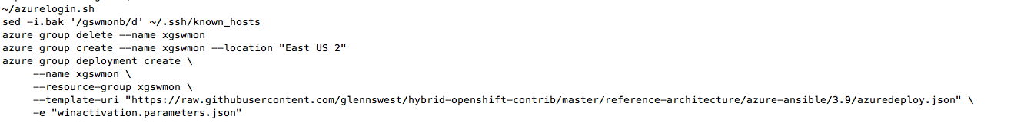
How to Use the Arm Templates
Install the ARM command line tools on your machine
https://docs.microsoft.com/en-us/cli/azure/install-azure-cli?view=azure-cli-latest
Create the Parameter Files
Login To Azure
Create a Resource Group for the cluster
Deploy It

Slide 7
Logging Into Azure
az login --service-principal -u <app-url> -p <password-or-cert> --tenant <tenant>
Note that you may also login to a “user” account as well.
Must have the ability to create and delete a resource group
Must have quota enough to deploy. Note the current script creates several machines, so it needs appropriate core limits
Must be able to create storage accounts
Microsoft Trial Accounts are truly no point. Don’t try. A min employee lasts no time with a trial account

Slide 8
Parameters File
JSON File
Provides all the parameter for deployment
RHN Username/Password
Default user login for cluster
Number of nodes
Azure Subscription Info
Settings
SSH Keys (Note you need to do a encode on the key)
Detailed Walkthru on Parameters:
https://access.redhat.com/documentation/en-us/reference_architectures/2017/html-single/deploying_red_hat_openshift_container_platform_3.6_on_microsoft_azure/index#parameters_required

Slide 9
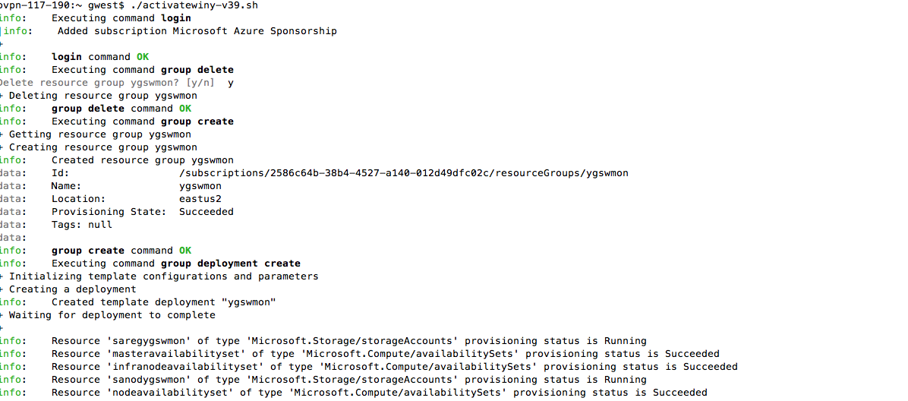
Example - Kickoff

Slide 10
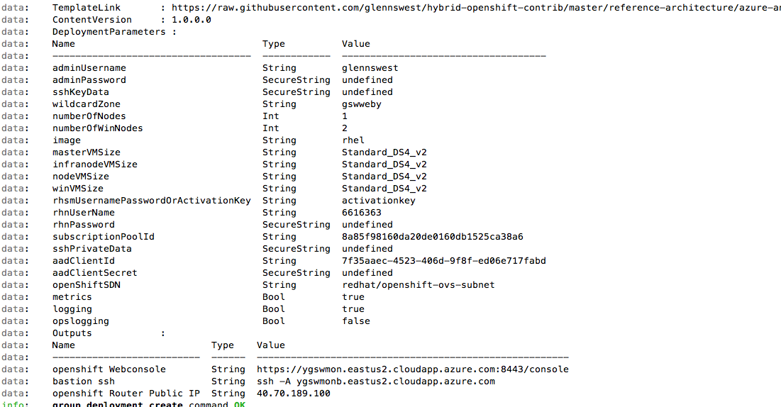
Example – End of ARM Deploy

Slide 11
Next Step (Note this is Temporary)
Ssh to username@hostname
Username is the one supplied in the paramters file
Hostname is returned at the end of the deployment
Full hostname will vary by azure zone its deployed in
This connections you to the bastion host

Slide 12
Next Step (Note this is Temporary)
Run:
Openshift-install.sh (As Root)
Git pull https://github.com/glennswest/hybrid
setup-clients.sh
As root: ansible-playbook ovn_presetup.yml
As root: ansible-playbook ovn_postsetup.yml
As root: ansible-playbook recreate-containers.yml
As root: recreate-console.sh
As root: windows.yml

Slide 13
Using Hybrid Scripts Independently
OVN Setup
ovn_presetup/ovn_postsetup
Windows nodes requires ovn SDN solution. Currently its not integrated into ocp, The scripts builds upstream, installed it, and configures it, post openshift install. You must choose Redhat SDN disabled, and the cni plugin.
Ansible inventory file: Please console the hybrid_openshift_contrib bastion.sh which creates the inventory file for reference
Expects normal subscriptions to already be existing
Must be able to do yum installs

Slide 14
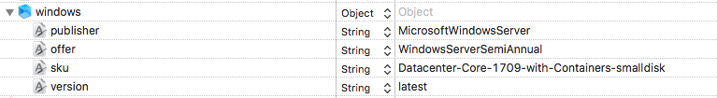
Windows Nodes
Window Nodes are expected to be:
Notes this specification on Azure allows for the latest image to be used at time of install.

Slide 15
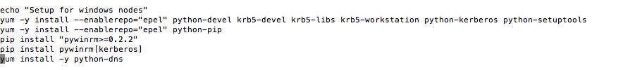
Installation using windows.yml
Uses Ansible on Windows
Must have a windows group in ansible inventory
If using script separately, must do some setup before:

Slide 16
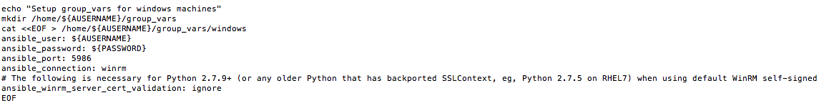
Setting up Windows group_vars
Must create a group_vars to setup windows nodes
The following is done automatically in bastion.sh in the ARM template

Slide 17
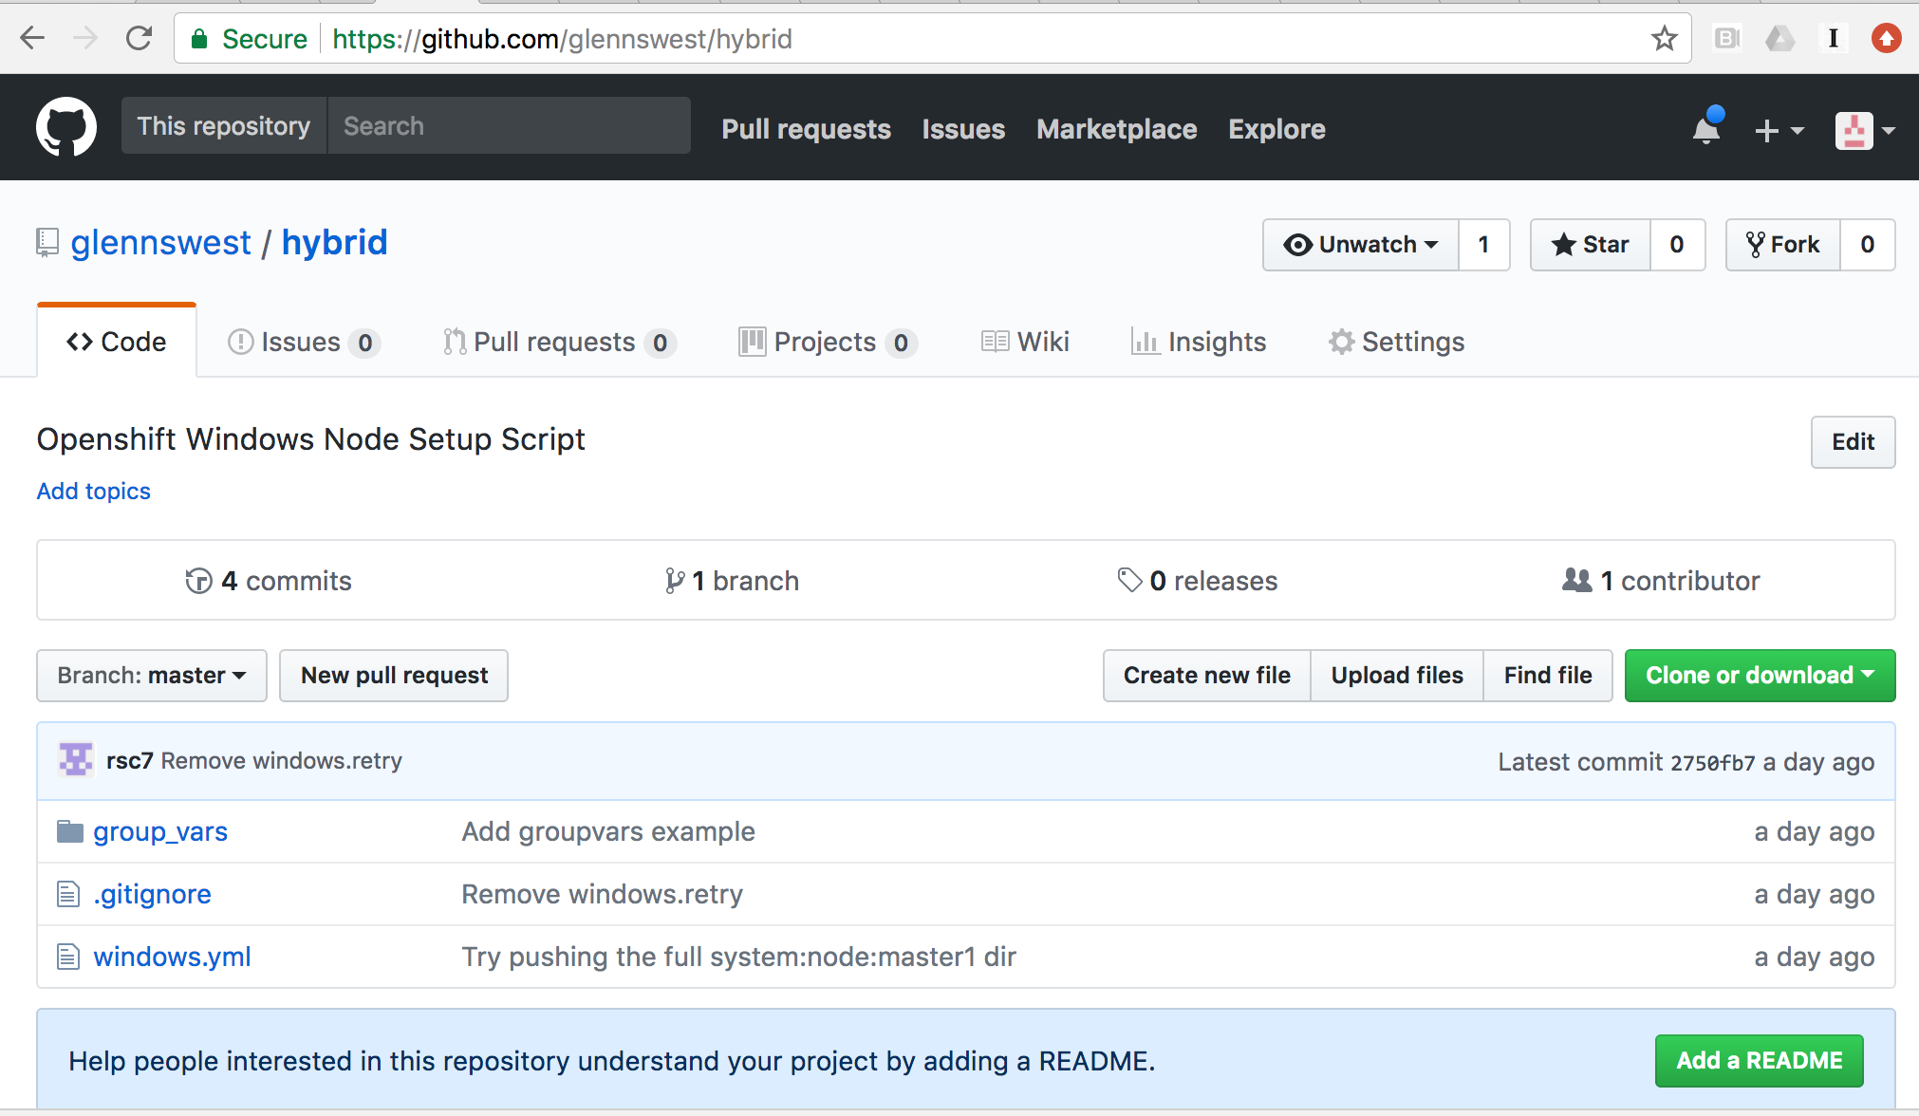
Hybrid Script – Windows Node Setup

Slide 18
Current Issues and Problems
OVN Network Stability Improvement – No Proxy option needs to be implemented
Automatic Run of ovn/windows scripts during deployment
More testing with windows
See epic on trello

